Slide 1



Crypto Analysis
& Predictor
Final Project
Gonzalo Begara
Notes:
Being back to our costumer focus / customer council
Innovation / External orientation.
Innovation mindset (not only FTEs)

Slide 2

AGENDA
1
PROJECT MOTIVATION
2
BASIC THEORY
3
NEURAL NETWORK MODEL (LSTM)
4
MACD MODEL
5
OBV MODEL

Slide 3

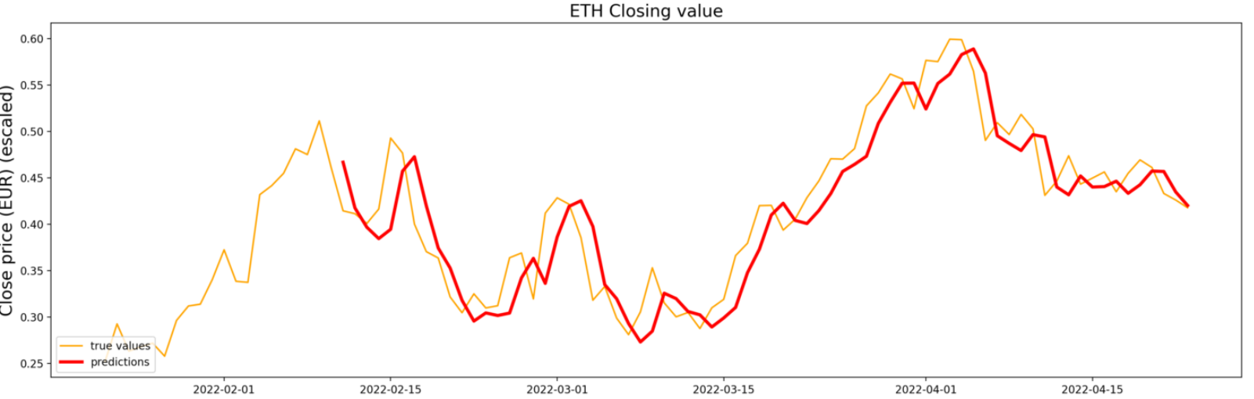
PROJECT MOTIVATION
Degree in
Business Administration
Interest
for innovation

Slide 4





BASIC THEORY- DATA API
TYPE OF INFORMATION
High price
Low price
Open price
Close price
Volume
Adj Close
CRYPTO INFO
API

Slide 5
BASIC THEORY
NEURAL NETWORK LSTM - PREDICTOR
Long Short Term Memory (LSTM)
Timeseries neural network model
It uses long-term and short-term data to predict the future
SELL
BUY

Slide 6
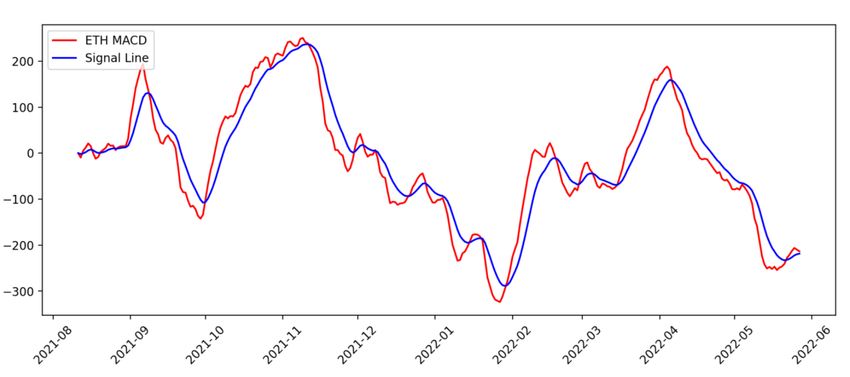
BASIC THEORY
MACD MODEL- INDICATOR
Moving Average convergence/ divergence (MACD)
Short term = 12 periods
Long term = 26 periods
MACD = Short term exponential moving average (EMA) – long term EMA
Signal is the EMA of the MACD with 9 periods
SELL
BUY

Slide 7
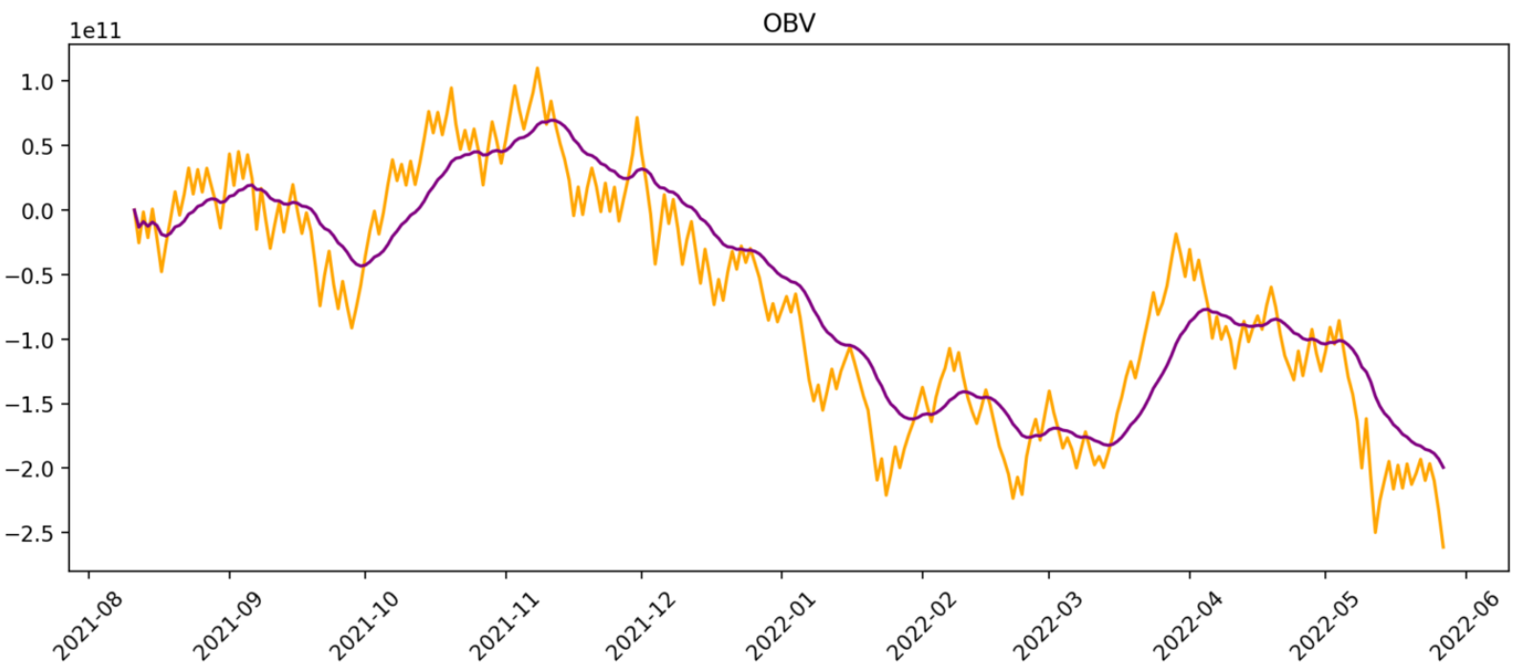
BASIC THEORY
OVB MODEL- MOMENTUM INDICATOR
On-Balance Volume (OBV)
It uses changes in volume to predict changes in stock price
OBV shows crowd sentiment that can predict a bullish or bearish outcome
OBV’s EMA with 26 periods
SELL
BUY

Slide 8
Thank you all for your attention!
"If you have more than 120 or 130 I.Q. points, you can
afford to give the rest away. You don't need extraordinary
intelligence to succeed as an investor."
-Warren Buffet

Slide 9
QUESTIONS?
Thank you all for your attention!

